Slide 1

PYTHON
INHERITANCE

Slide 2

OBJECTIVES
About Inheritance.
Types of Inheritance.
Method Overriding.

Slide 3
USAGE
Code reusability
Based on real life example.

Slide 4
Python Inheritance
When a class inherit properties from other class:
The class which inherit the properties is known as child class
The class from which properties are inherited is known as parent class..

Slide 5
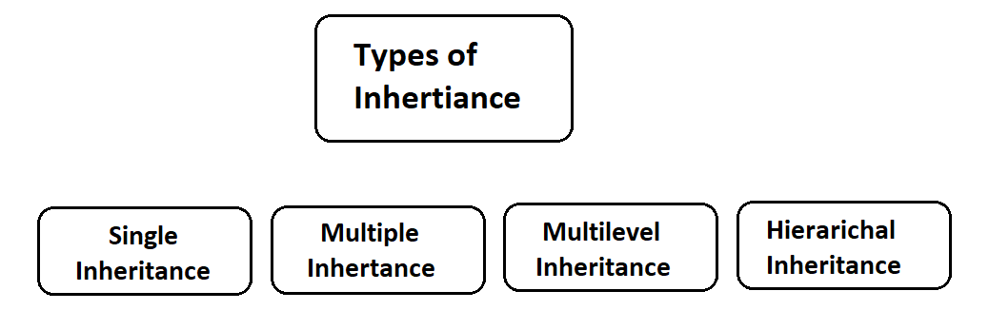
Types of Inheritance:

Slide 6
SINGLE INHERITANCE
When there in only on level of inheritance
One child class, one parent class

Slide 7
MULTIPLE INHERITANCE
When a child class inherits property from the multiple classes.

Slide 8
MULTILEVEL INHERITANCE
When the child class inherits property from the parent class but also gives property to another child class.

Slide 9
HIERARICHAL INHERITANCE
When the same parent class is giving properties to multiple child classes.

